Slide 1


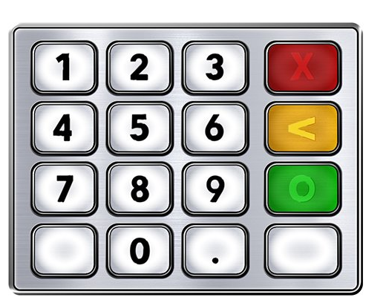

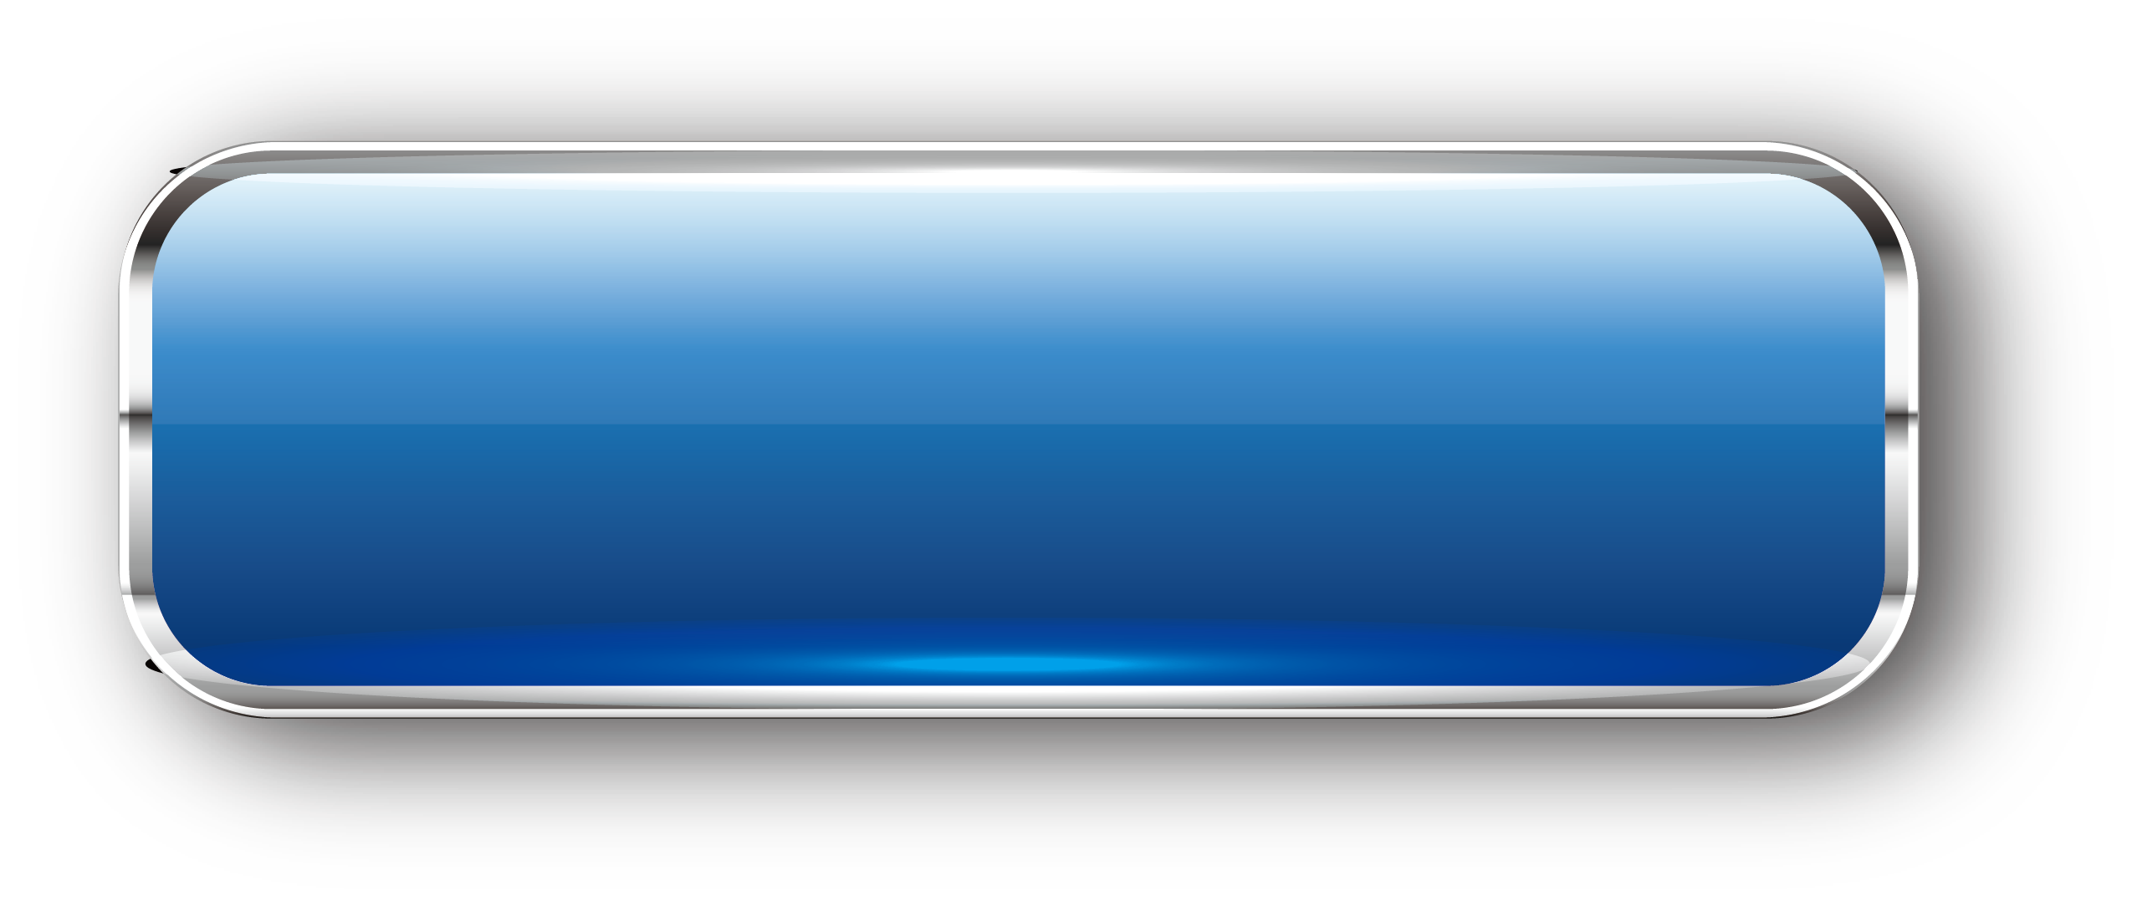
STM32 – ARM CORTEX M
LAB 6:
GPIO – BUTTON KEYPAD
STM32 EMBEDDED PROGRAMING
DO TRUNG HAU

Slide 2

CONTENTS
1. INPUT DATA OPERATION
2. PRESS AND RELEASE BUTTON
3. PRESS AND HOLD BUTTON
4. MATRIX OF BUTTON - KEYPAD
STM32 EMBEDDED SYSTEMS
ARM CORTEX M

Slide 3
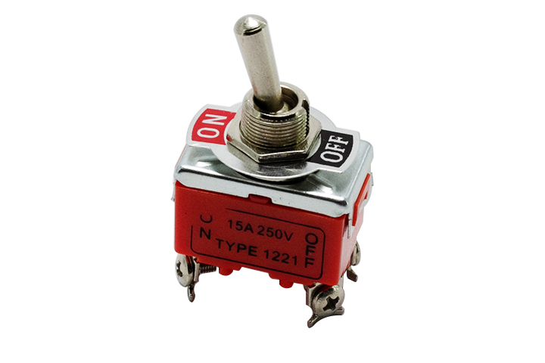
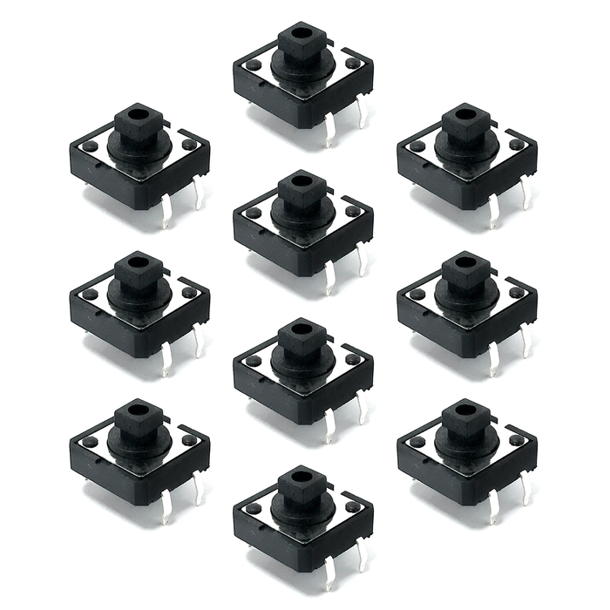
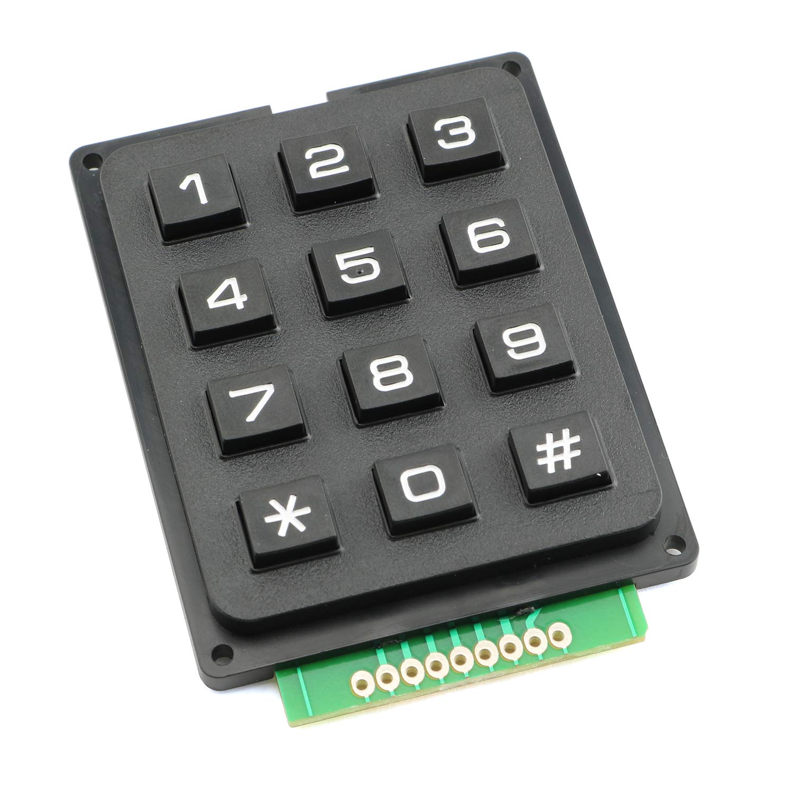
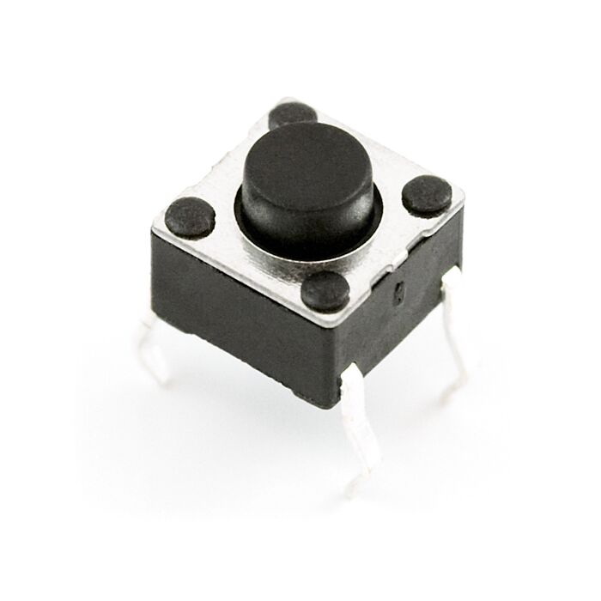
LAB 5: GPIO – BUTTON - KEYPAD
1. INPUT DATA OPERATION
SINGLE BUTTON
STM32 EMBEDDED SYSTEMS
ARM CORTEX M

Slide 4
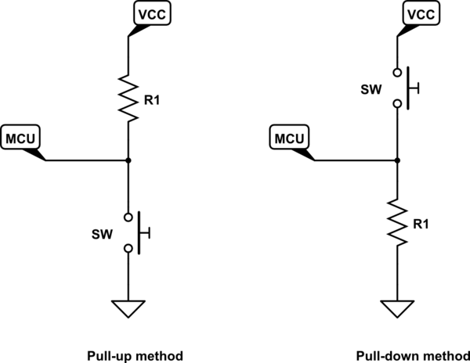
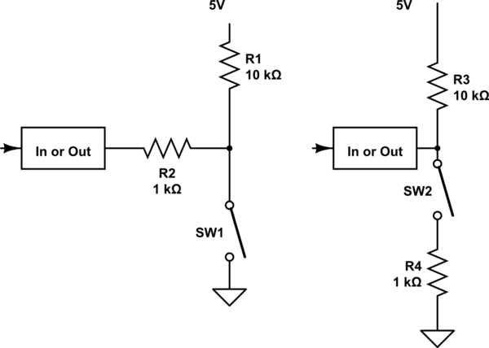
LAB 5: GPIO – BUTTON - KEYPAD
1. INPUT DATA OPERATION
SINGLE BUTTON
STM32 EMBEDDED SYSTEMS
ARM CORTEX M

Slide 5
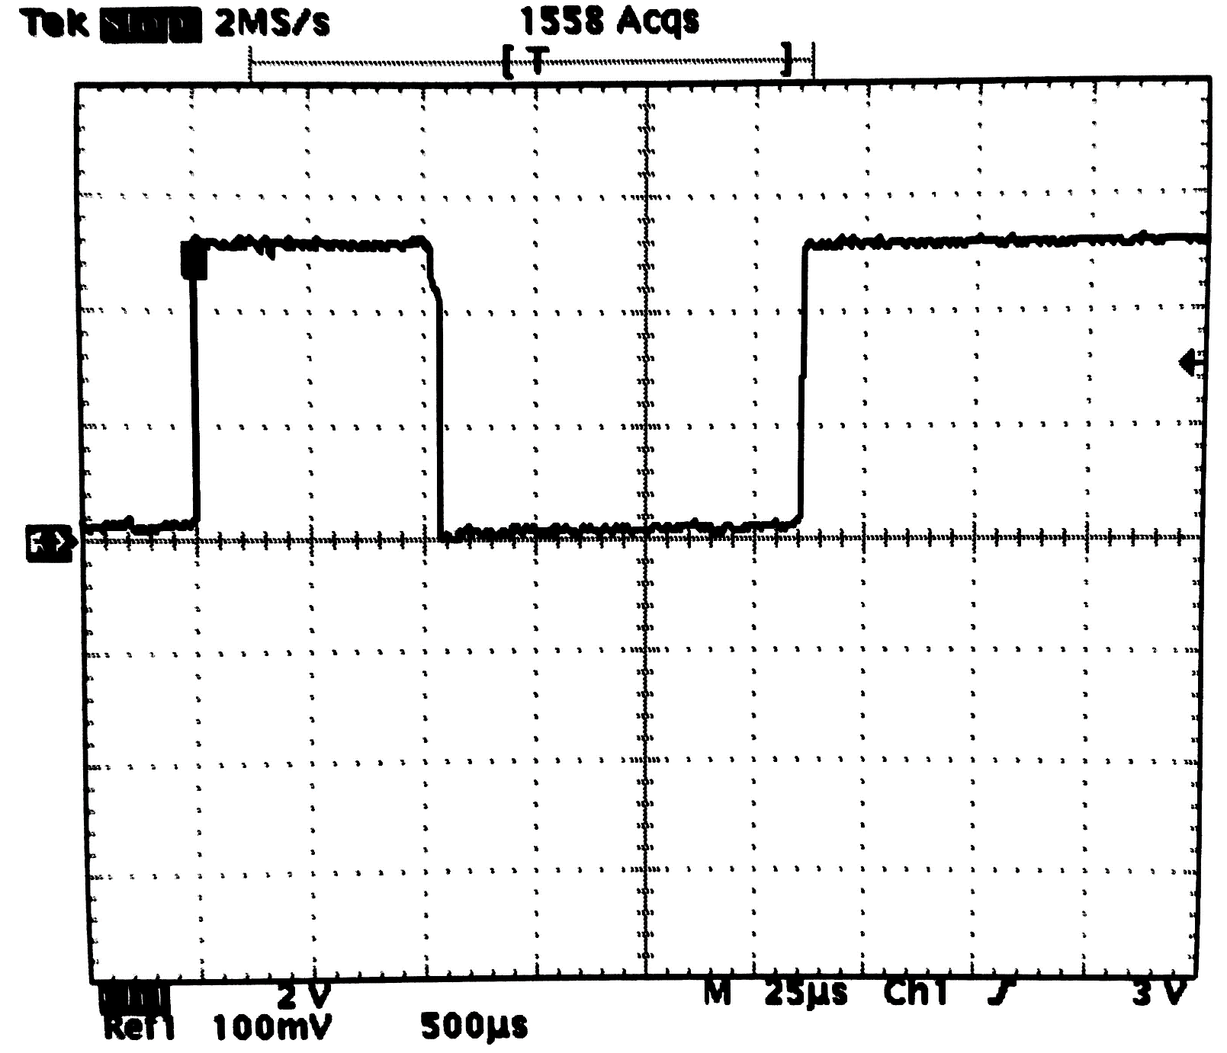
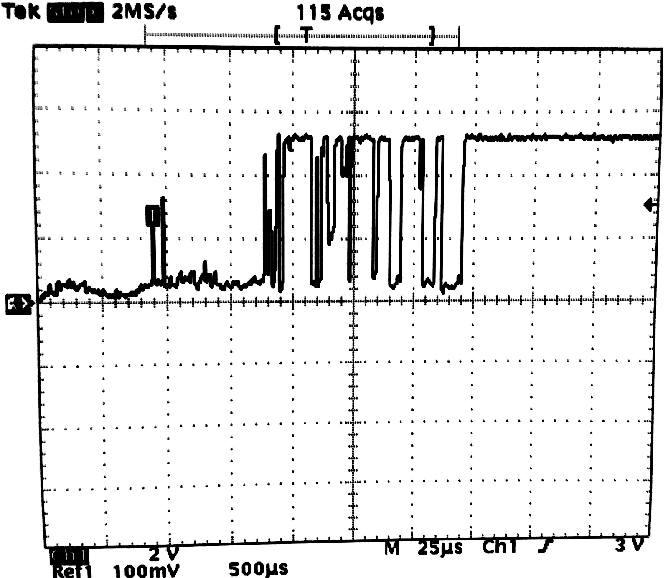
LAB 5: GPIO – BUTTON - KEYPAD
1. INPUT DATA OPERATION
SINGLE BUTTON
STM32 EMBEDDED SYSTEMS
ARM CORTEX M

Slide 6
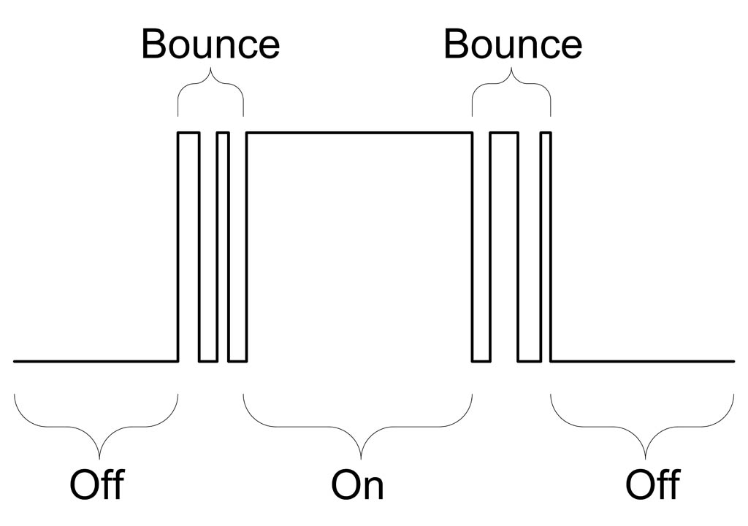
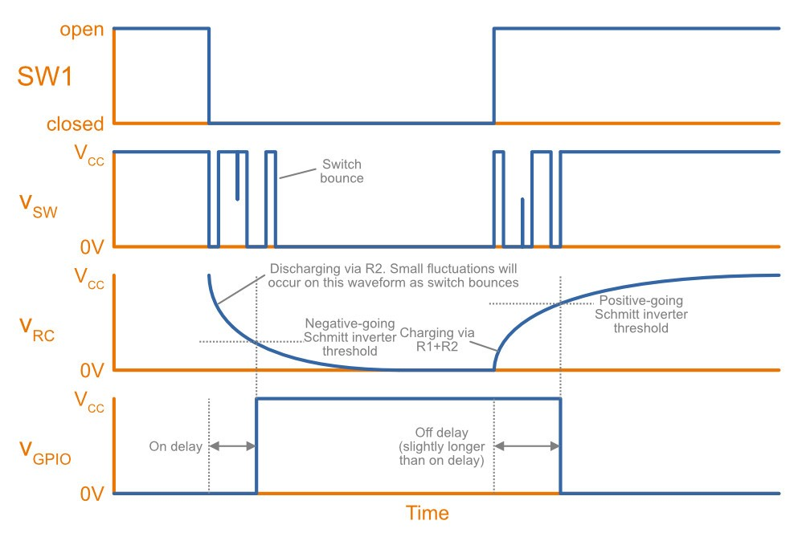
LAB 5: GPIO – BUTTON - KEYPAD
1. INPUT DATA OPERATION
SINGLE BUTTON
STM32 EMBEDDED SYSTEMS
ARM CORTEX M

Slide 7
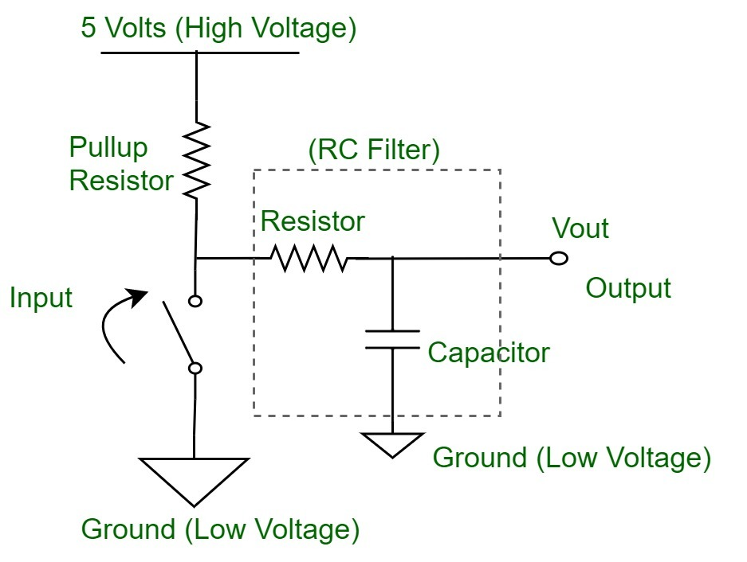
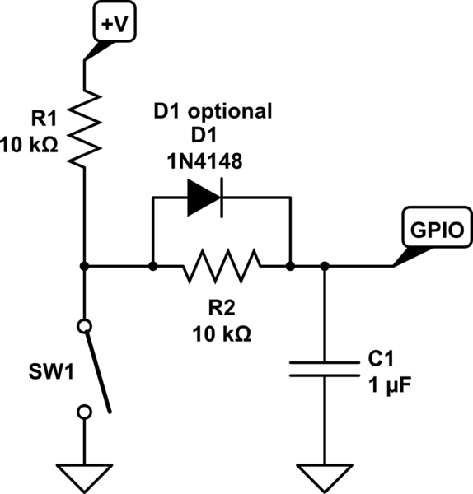
LAB 5: GPIO – BUTTON - KEYPAD
1. INPUT DATA OPERATION
SINGLE BUTTON
STM32 EMBEDDED SYSTEMS
ARM CORTEX M

Slide 8
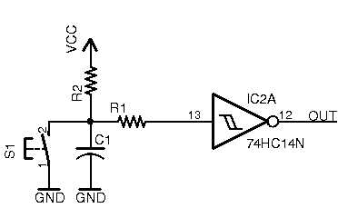
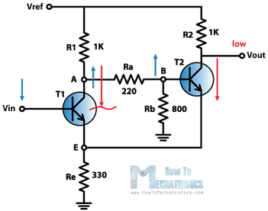
LAB 5: GPIO – BUTTON - KEYPAD
1. INPUT DATA OPERATION
SINGLE BUTTON
STM32 EMBEDDED SYSTEMS
ARM CORTEX M

Slide 9
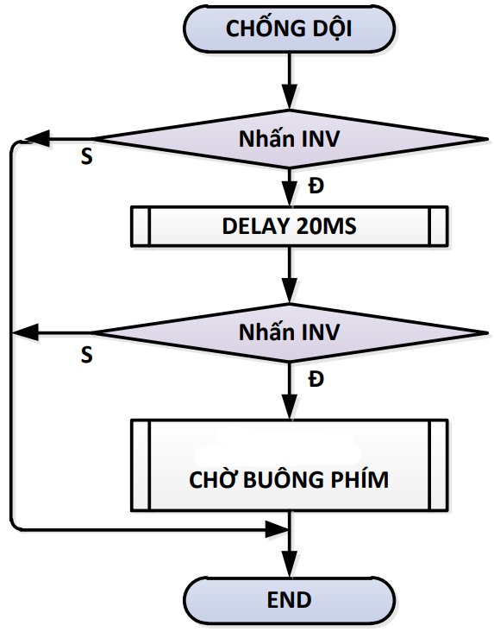
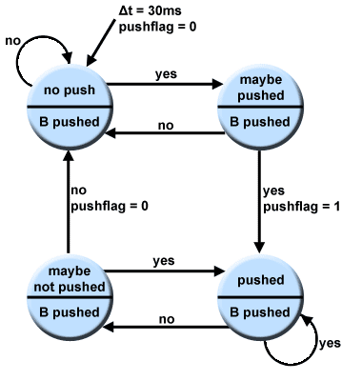
LAB 5: GPIO – BUTTON - KEYPAD
1. INPUT DATA OPERATION
SINGLE BUTTON
STM32 EMBEDDED SYSTEMS
ARM CORTEX M

Slide 10
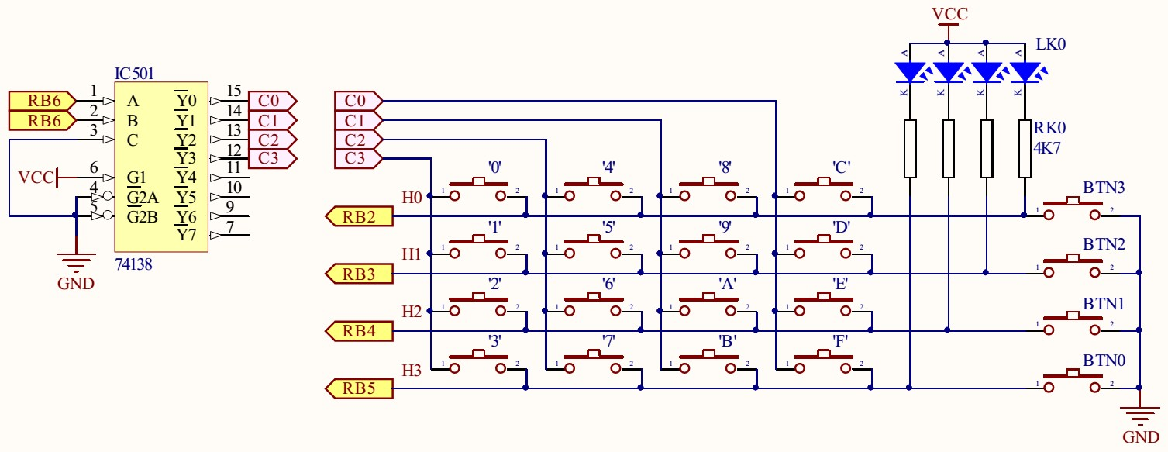
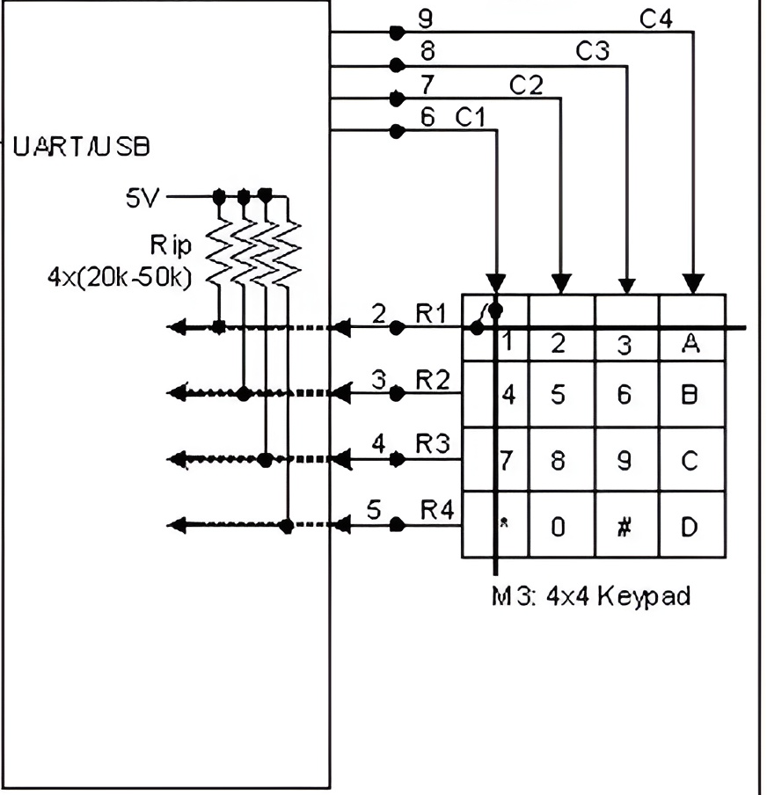
LAB 5: GPIO – BUTTON - KEYPAD
1. INPUT DATA OPERATION
SINGLE BUTTON
STM32 EMBEDDED SYSTEMS
ARM CORTEX M

Slide 11
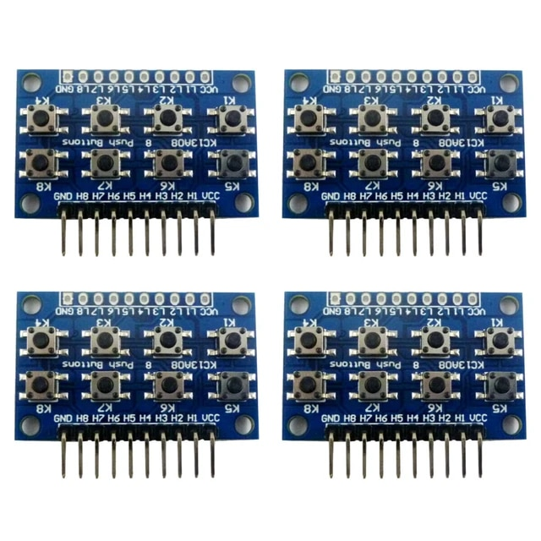
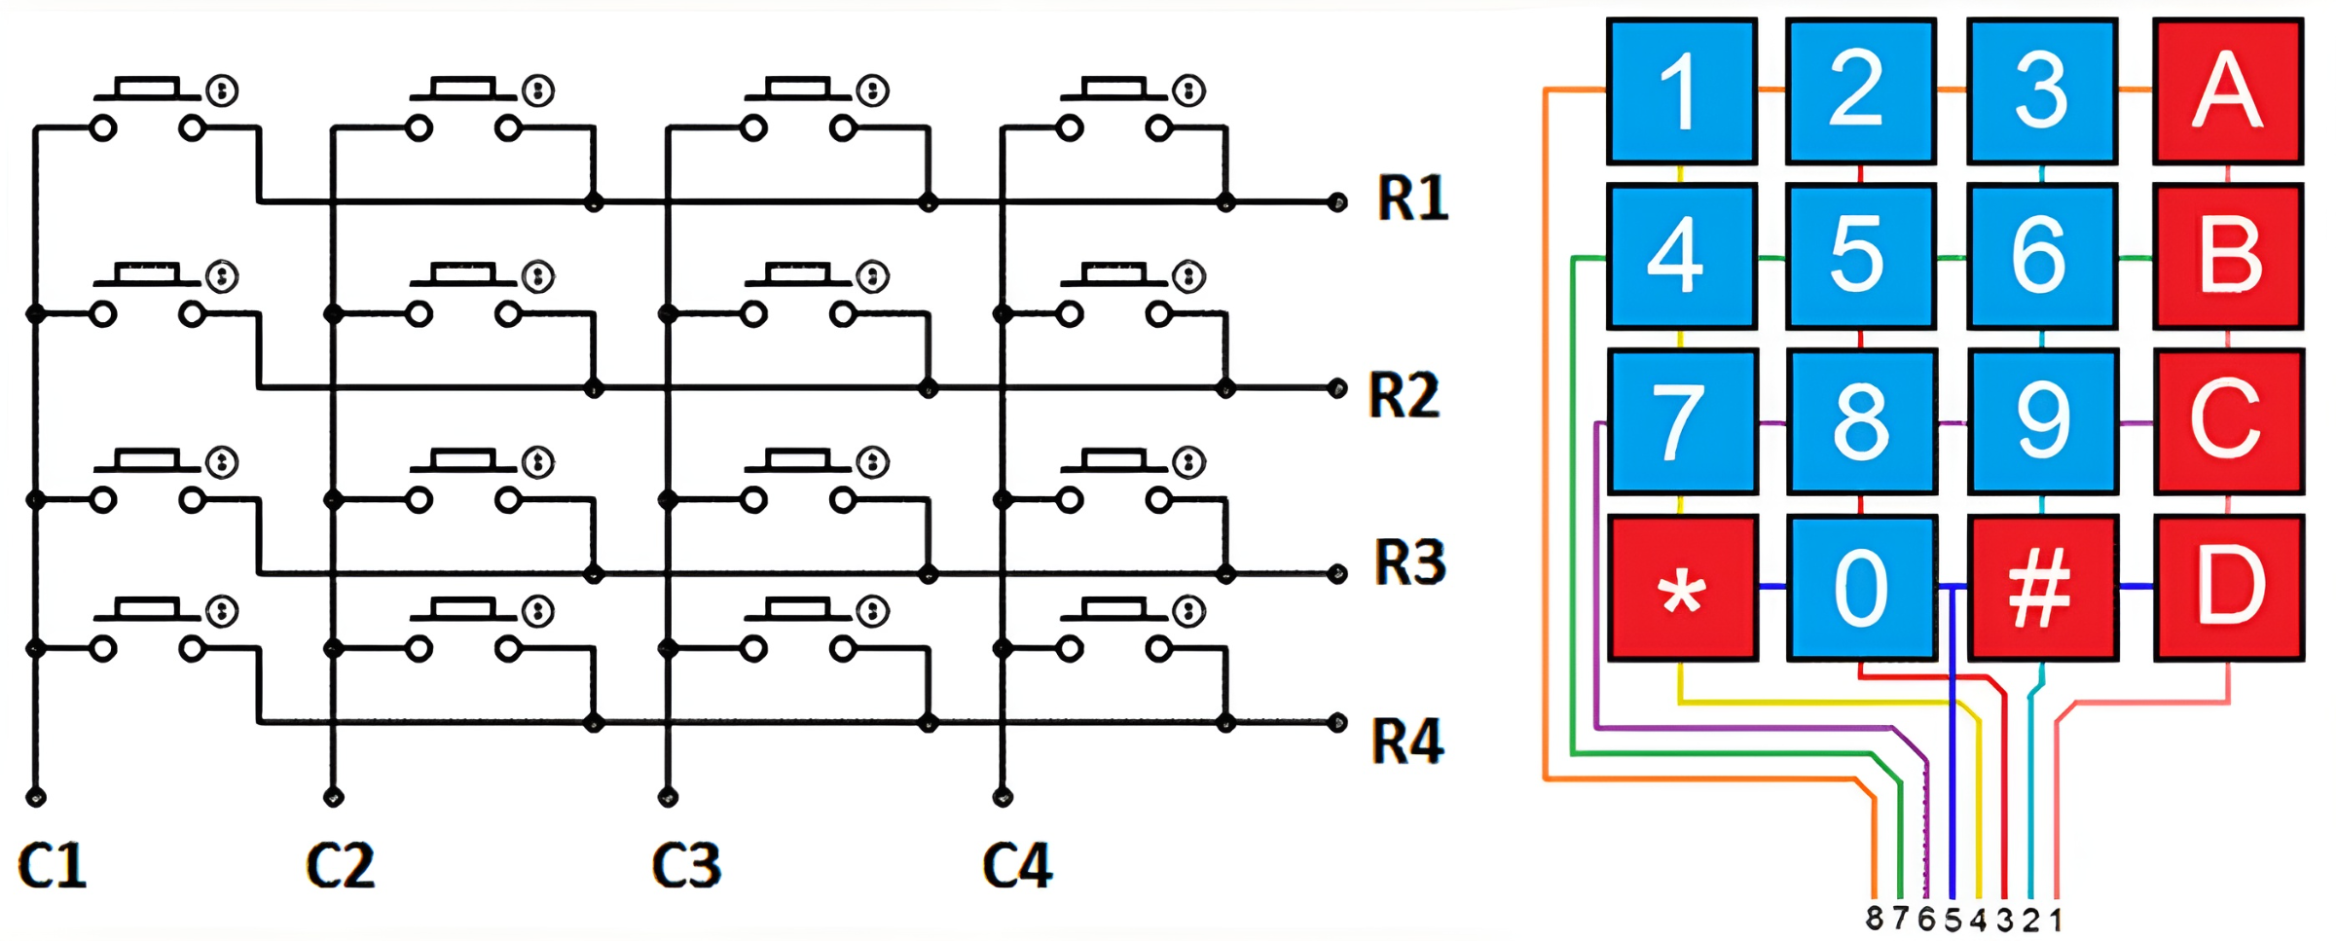
LAB 5: GPIO – BUTTON - KEYPAD
1. INPUT DATA OPERATION
SCHEMATIC
STM32 EMBEDDED SYSTEMS
ARM CORTEX M

Slide 12
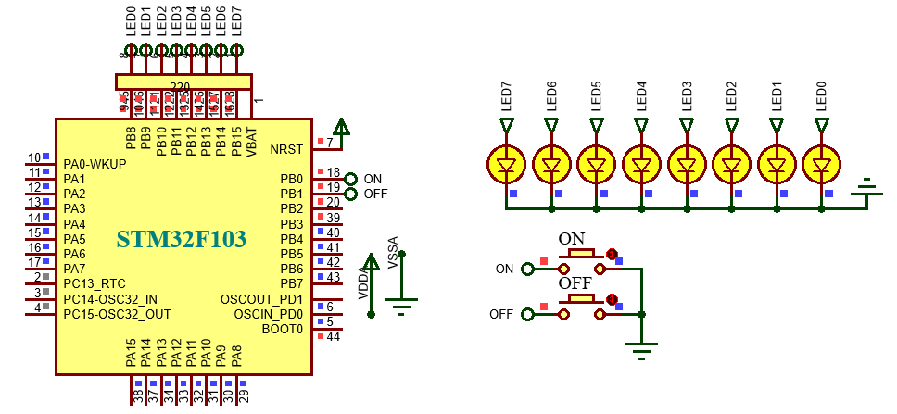
LAB 5: GPIO – BUTTON - KEYPAD
2. PRESS AND RELEASE BUTTON
P1. Write a program to control 8 LEDs by 2 button “ON” and “OFF”. Press ON to make all 8 LEDs light up, press ON to make all 8 LEDs off.
STM32 EMBEDDED SYSTEMS
ARM CORTEX M

Slide 13
LAB 5: GPIO – BUTTON - KEYPAD
P1. Write a program to control 8 LEDs by 2 button “ON” and “OFF”. Press ON to make all 8 LEDs light up, press ON to make all 8 LEDs off.
void output_8bit(char byte)
{
HAL_GPIO_WritePin(GPIOB,GPIO_PIN_15,(GPIO_PinState)(byte&128));
HAL_GPIO_WritePin(GPIOB,GPIO_PIN_14,(GPIO_PinState)byte&64));
HAL_GPIO_WritePin(GPIOB,GPIO_PIN_13,(GPIO_PinState)(byte&32));
HAL_GPIO_WritePin(GPIOB,GPIO_PIN_12,(GPIO_PinState)(byte&16));
HAL_GPIO_WritePin(GPIOB, GPIO_PIN_11,(GPIO_PinState)(byte&8));
HAL_GPIO_WritePin(GPIOB, GPIO_PIN_10,(GPIO_PinState)(byte&4));
HAL_GPIO_WritePin(GPIOB, GPIO_PIN_9,(GPIO_PinState)(byte&2)); HAL_GPIO_WritePin(GPIOB, GPIO_PIN_8,(GPIO_PinState)(byte&1));
}
STM32 EMBEDDED SYSTEMS
ARM CORTEX M

Slide 14
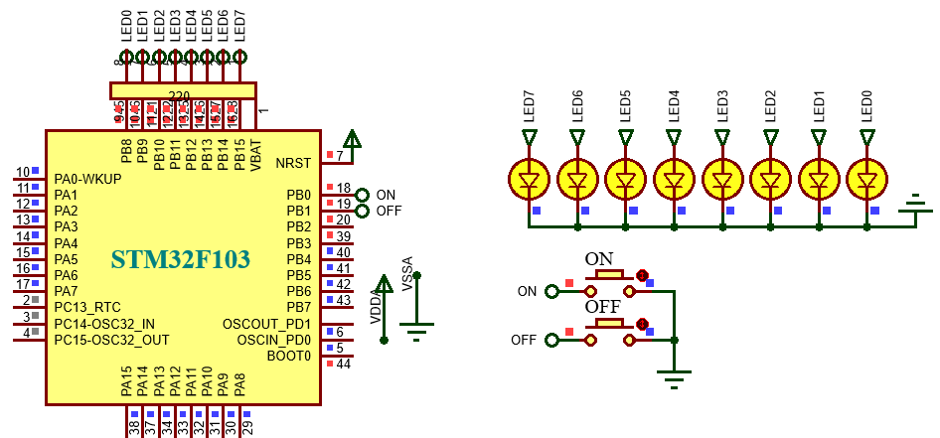
LAB 5: GPIO – BUTTON - KEYPAD
P1. Write a program to control 8 LEDs by 2 button “ON” and “OFF”. Press ON to make all 8 LEDs light up, press ON to make all 8 LEDs off.
if(!HAL_GPIO_ReadPin(GPIOB, GPIO_PIN_0))
output_8bit(0xff);
if(!HAL_GPIO_ReadPin(GPIOB, GPIO_PIN_1))
output_8bit(0);
STM32 EMBEDDED SYSTEMS
ARM CORTEX M

Slide 15
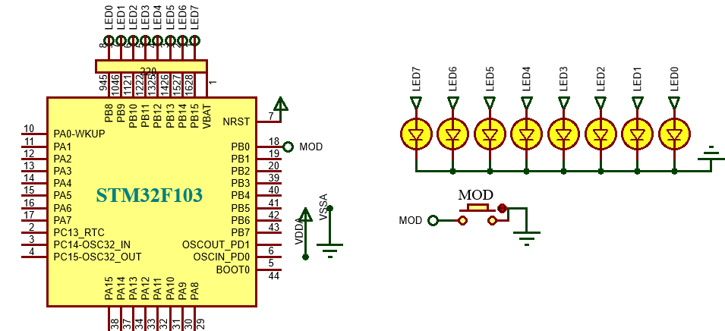
LAB 5: GPIO – BUTTON - KEYPAD
2. PRESS AND RELEASE BUTTON
P2. Write a program to control 8 LEDs by 1 button MOD. Press MOD to make all 8 LEDs light up, press MOD again to make all 8 LEDs off.
STM32 EMBEDDED SYSTEMS
ARM CORTEX M

Slide 16
LAB 5: GPIO – BUTTON - KEYPAD
2. PRESS AND RELEASE BUTTON
if(!HAL_GPIO_ReadPin(GPIOB, GPIO_PIN_0))
{
HAL_Delay(20);
if(!HAL_GPIO_ReadPin(GPIOB, GPIO_PIN_0))
{
status =~status;
if(status) output_8bit(0xff);
else output_8bit(0);
while(!HAL_GPIO_ReadPin(GPIOB, GPIO_PIN_0));
}
}
STM32 EMBEDDED SYSTEMS
ARM CORTEX M

Slide 17
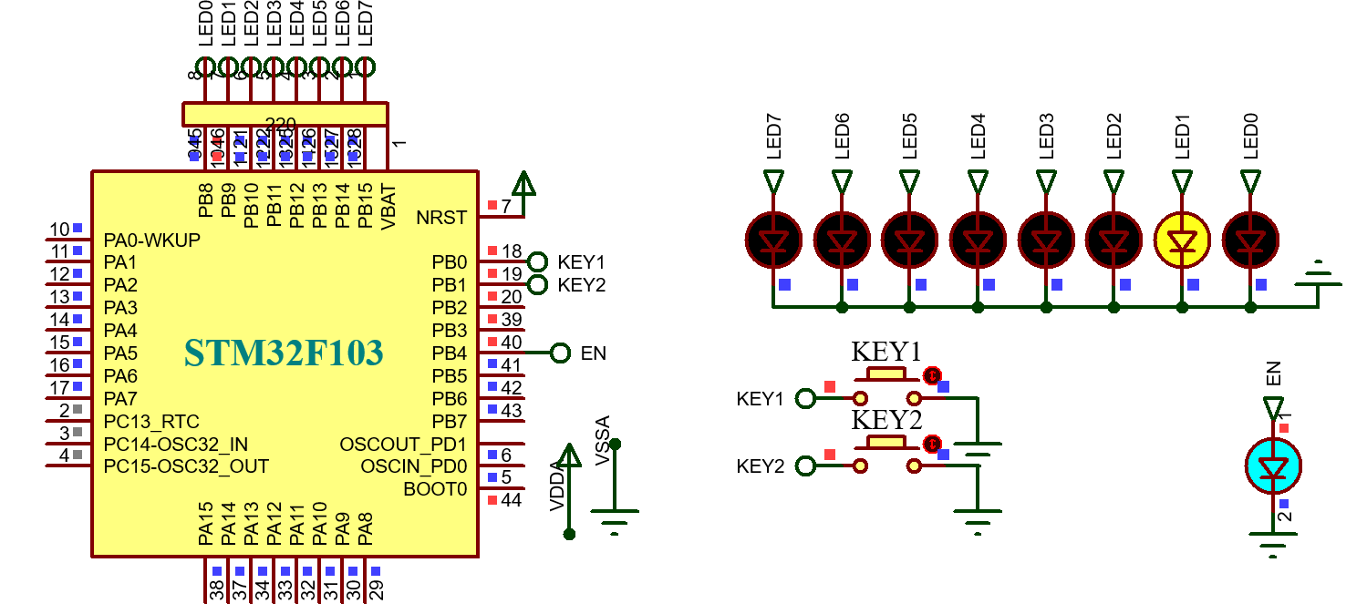
LAB 5: GPIO – BUTTON - KEYPAD
2. PRESS AND RELEASE BUTTON
P3. Write a function “key_debounced(key);” to get the value of input key and debounce. Then connected 3 button “KEY1, KEY2” . Press KEY1 to enable KEY2, press KEY2 to control one point of led shifting from left to right.
STM32 EMBEDDED SYSTEMS
ARM CORTEX M

Slide 18
LAB 5: GPIO – BUTTON - KEYPAD
2. PRESS AND RELEASE BUTTON
uint8_t enable, led, i;
uint8_t key_debounced(uint8_t key)
{
if(!HAL_GPIO_ReadPin(GPIOB, key))
{
HAL_Delay(20);
if(!HAL_GPIO_ReadPin(GPIOB, key))
{
while(!HAL_GPIO_ReadPin(GPIOB, key));
return 1;
} return 0;
} return 0;
}
STM32 EMBEDDED SYSTEMS
ARM CORTEX M

Slide 19
LAB 5: GPIO – BUTTON - KEYPAD
2. PRESS AND RELEASE BUTTON
if(key_debounced(GPIO_PIN_0))
{
enable = ~enable;
if(enable) HAL_GPIO_WritePin(GPIOB,GPIO_PIN_4,GPIO_PIN_SET);
else HAL_GPIO_WritePin(GPIOB,GPIO_PIN_4,GPIO_PIN_RESET);
}
if(enable)
{
if(key_debounced(GPIO_PIN_1))
{
led = 0x80 >> i; output_8bit(led);
i++; i%=9;
}
};
STM32 EMBEDDED SYSTEMS
ARM CORTEX M

Slide 20
LAB 5: GPIO – BUTTON - KEYPAD
3. PRESS AND HOLD BUTTON
P4. Write a program to control 8 led with button SHIFT. Press and hold SHIFT to control one point of led shifting from left to right.
STM32 EMBEDDED SYSTEMS
ARM CORTEX M

Slide 21
LAB 5: GPIO – BUTTON - KEYPAD
3. PRESS AND HOLD BUTTON
P4. Write a program to control 8 led with button SHIFT. Press and hold SHIFT to control one point of led shifting from left to right.
if(!HAL_GPIO_ReadPin(GPIOB, GPIO_PIN_0))
{
HAL_Delay(200);
if(!HAL_GPIO_ReadPin(GPIOB, GPIO_PIN_0))
{
led = 0x80 >> i;
output_8bit(led);
i++; i%=9;
}
}
STM32 EMBEDDED SYSTEMS
ARM CORTEX M

Slide 22
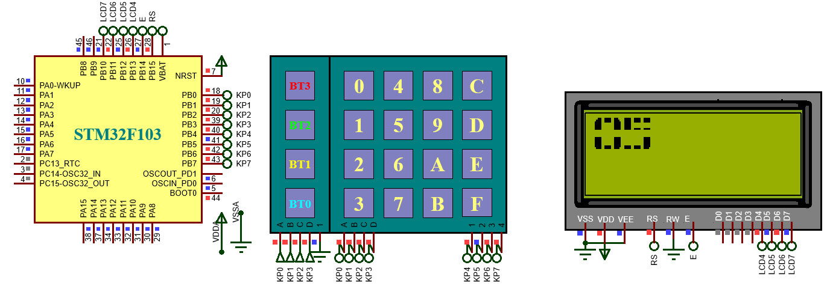
LAB 5: GPIO – BUTTON - KEYPAD
4. MATRIX OF BUTTON - KEYPAD
P5. Write a program to get the key code from keypad 4x4. Then display on LCD 20x4 the key code corresponding to the pressed key.
STM32 EMBEDDED SYSTEMS
ARM CORTEX M

Slide 23
LAB 5: GPIO – BUTTON - KEYPAD
4. MATRIX OF BUTTON - KEYPAD
P5. Write a program to get the key code from keypad 4x4. Then display on LCD 20x4 the key code corresponding to the pressed key.
const char scan_kp[4] = {0x07, 0x0b, 0x0d, 0x0e};
void output_kp(uint8_t byte)
{
HAL_GPIO_WritePin(GPIOB,GPIO_PIN_4,(GPIO_PinState)(byte&8)); HAL_GPIO_WritePin(GPIOB,GPIO_PIN_5,(GPIO_PinState)(byte&4)); HAL_GPIO_WritePin(GPIOB,GPIO_PIN_6,(GPIO_PinState)(byte&2)); HAL_GPIO_WritePin(GPIOB,GPIO_PIN_7,(GPIO_PinState)(byte&1));
}
STM32 EMBEDDED SYSTEMS
ARM CORTEX M

Slide 24
LAB 5: GPIO – BUTTON - KEYPAD
4. MATRIX OF BUTTON - KEYPAD
uint8_t key_read(void)
{
uint8_t mp = 0xff;
for(uint8_t cot = 0; cot < 4; cot++)
{
output_kp(scan_kp[cot]);
if(!HAL_GPIO_ReadPin(GPIOB,GPIO_PIN_0)) {mp = cot*4; break;};
if(!HAL_GPIO_ReadPin(GPIOB,GPIO_PIN_1)) {mp = cot*4 + 1; break;}; if(!HAL_GPIO_ReadPin(GPIOB,GPIO_PIN_2)) {mp = cot*4 + 2; break;}; if(!HAL_GPIO_ReadPin(GPIOB,GPIO_PIN_3)) {mp = cot*4 + 3; break;};
}
return mp;
}
STM32 EMBEDDED SYSTEMS
ARM CORTEX M

Slide 25
LAB 5: GPIO – BUTTON - KEYPAD
4. MATRIX OF BUTTON - KEYPAD
uint8_t key4x4_read(void)
{
uint8_t mp1, mp2;
mp1 = key_read();
if(mp1 != 0xff)
{
HAL_Delay(20); mp1 = key_read();
do { HAL_Delay(5); mp2 = key_read(); }
while(mp2 == mp1);
}
return mp1;
}
STM32 EMBEDDED SYSTEMS
ARM CORTEX M

Slide 26
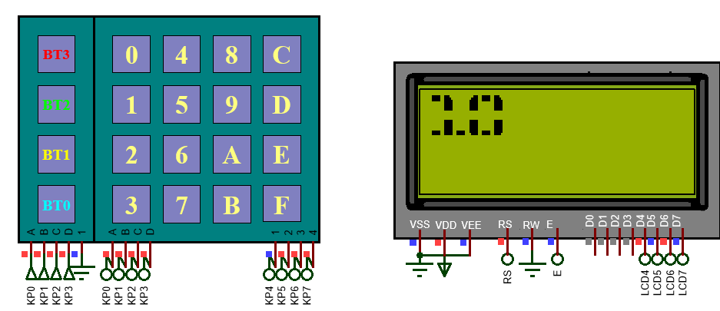
LAB 5: GPIO – BUTTON - KEYPAD
4. MATRIX OF BUTTON - KEYPAD
uint8_t mp;
mp = key4x4_read();
if(mp!=0xff)
{
lcd2x3_display(mp/10, 0,0);
lcd2x3_display(mp%10, 0,3);
}
STM32 EMBEDDED SYSTEMS
ARM CORTEX M

Slide 27

LAB 5: GPIO – BUTTON - KEYPAD
5. STATE MACHINE FOR BUTTON
DOUBLE CLICK
SINGLE
CLICK
START
0
700
250
STM32 EMBEDDED SYSTEMS
ARM CORTEX M
ARM CORTEX M

Slide 28



LAB 5: GPIO – BUTTON - KEYPAD
5. STATE MACHINE FOR BUTTON
P6. Write a program to read the status of button: single click, double click and long click.
STM32 EMBEDDED SYSTEMS
ARM CORTEX M
ARM CORTEX M

Slide 29

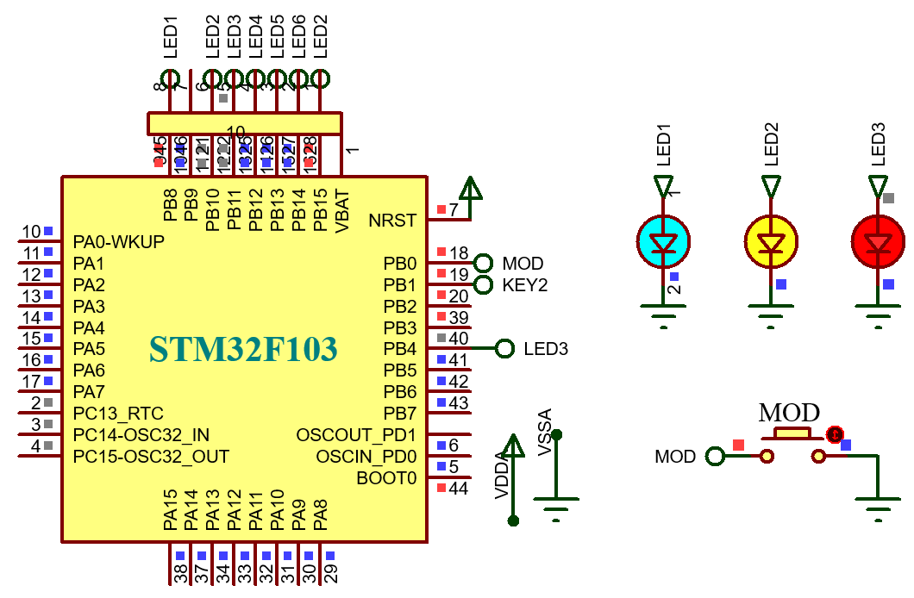
LAB 5: GPIO – BUTTON - KEYPAD
5. STATE MACHINE FOR BUTTON
P6. Write a program to read the status of button MOD: single click, double click and long click. Single click to turn on LED1 and single click again to turn off. Double click and long click are corresponding LED2 and LED 3 .
STM32 EMBEDDED SYSTEMS
ARM CORTEX M
ARM CORTEX M

Slide 30
LAB 5: GPIO – BUTTON - KEYPAD
status = BUTTON_Read();
if(status == DOUBLE_CLICK)
{
HAL_GPIO_TogglePin(GPIOB, GPIO_PIN_8);
HAL_Delay(500); status = 0; }
else if(status == SINGLE_CLICK)
{
HAL_GPIO_TogglePin(GPIOB, GPIO_PIN_15);
HAL_Delay(500); status = 0; }
else if(status == LONGCLICK)
{
HAL_GPIO_TogglePin(GPIOB, GPIO_PIN_4);
HAL_Delay(500); status = 0; }
STM32 EMBEDDED SYSTEMS
ARM CORTEX M
ARM CORTEX M

